Slide 1
Modeling the Impact of Economic Resources on Immigrants’ Behavior Patterns
...

Slide 2
Table of contents
I.
II.
III.
Introduction
Defining the Problem
Why Agent-Based Modeling(ABM)?
IV.
Identifying the Agents and Interactions
Agent's Behavior
Agent-Environment Interaction

Slide 3
Table of contents
V.
VI.
Designing the environment
Obtaining data: Rules and behaviors
Artificial Data Generation
Calculation of Livability Score
Agent Satisfaction Calculation
Random Movement and Exploration
VII.
Define the Time Step

Slide 4
Table of contents
VIII.
IX.
Flowchart
Pseudocode
X.
NetLogo: Interface and Code
Outputs
XI.
XII.
Suggested Scenarios (Extensions)
Disasters Extension
Controlled Migration Influx Extension
Social Network Influence

Slide 5
Introduction
*

Slide 6
Introduction
Migration has shaped human societies throughout history. Dynamic process influenced by
economic opportunities
environmental conditions
infrastructural development
ABM is used to explain such complex phenomenon whilst revealing the complex relationships between economic resources and immigration behavior
}
..

Slide 7

Migration is not a homogenous concept but diverse. It is affected by geopolitical factors, where immigrates would feel more stable choosing a country to flee to, according to their preferences.
*

Slide 8
Definition of the problem
Simulating the decision-making processes of individual immigrants, considering their preferences, environmental factors, and the economic resources available in their surroundings.
“How do environmental, economic, and infrastructure factors influence the migration behavior of agents (immigrants), and how does this impact the overall pattern of migration?”
}
..

Slide 9
“How do environmental, economic, and infrastructure factors influence the migration behavior of agents (immigrants), and how does this impact the overall pattern of migration?”
-To answer the core question, the model will:
examine the interactions between agents (immigrants) and their environment
explore how specific economic indices impact the decision to migrate.
-To provide more details, the research will seek to:
Identify thresholds and critical livability values that trigger migration.
provide insights into the conditions under which individuals are compelled to seek new environments.
}
..

Slide 10
Identifying the Agents and Interactions:
}
..

Slide 11
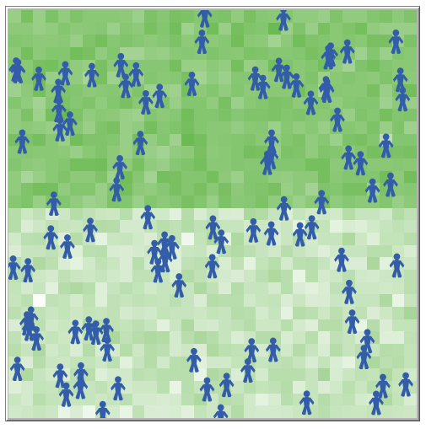
Designing the Environment
2D space represented by Patches.
Spatial Division: divided along the horizontal axis, where lower half represents region with low economic resources and livability score and vice versa in the higher half.
Random Assignment of Economic Resources:
3 variables assigned in each patch (“Environment”, “economic resources”, “infrastructure”)
Lower with limited resources: 1 < x < 5
Upper with Abundant resources: 6 < x < 10

Slide 12
Designing the Environment
Calculation of Livability Score:
The score reflects the overall desirability of a patch.
It is calculated through Euclidean L2 norm of the vector composed of the 3 variables
Color Representation:
From green to Brown
Higher livability scores: greener colors
lower livability scores: browner colors
Dynamic Nature:
simulates the real-world variability and unpredictability of resource distribution and livability.

Slide 13
Obtaining Data: Rules and Behaviors
1. Artificial Data Generation:
2. Calculation of Livability Score:
The model generates hypothetical variables for the environment and agents’ preferences.
Agents’ preferences
(env, econ, infra)
Assigned between 0 and 1
L2 Norm (Euclidean) Calculation is used to assign each patch with an overall livability score.

Slide 14
Obtaining Data: Rules and Behaviors
3. Agent Satisfaction Calculation:
4.Random Movement and Exploration:
Random movement reflects the real world unpredictability, where we can see the initial place of agents and find out how and where they will end up.
Agents explore their preferred patch according to satisfactory threshold.
Dot Product Calculation of the agent's preference vector and the livability vector of its current patch

Slide 15
Defining Time-step
the tick command as (weeks), suggesting a discrete time progression.

Slide 16
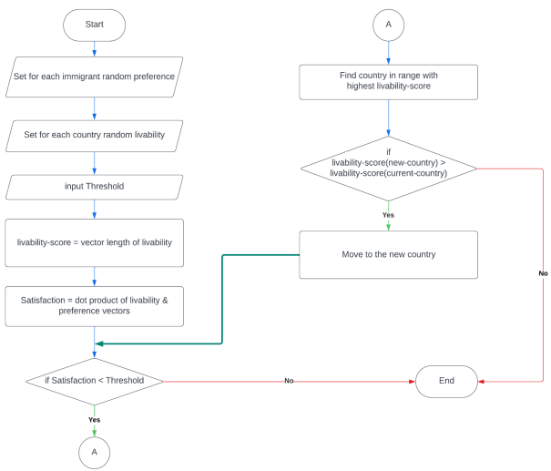
Flowchart

Slide 17
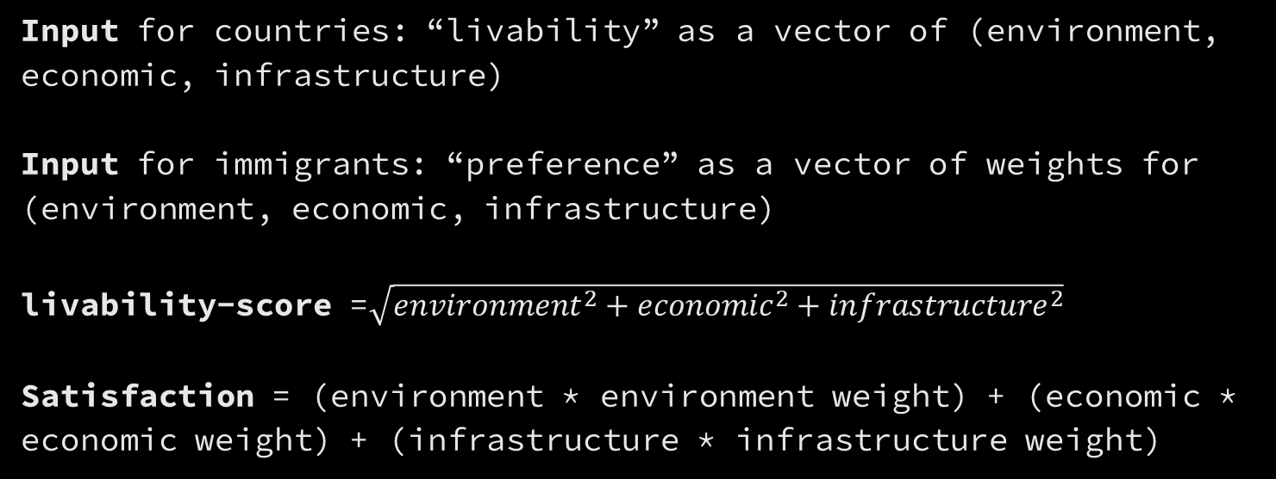
Pseudocode
Input for countries: “livability” as a vector of (environment, economic, infrastructure)
Input for immigrants: “preference” as a vector of weights for (environment, economic, infrastructure)
livability-score =$\sqrt{{environment}^{2}+{economic}^{2}+{infrastructure}^{2}}$
Satisfaction = (environment * environment weight) + (economic * economic weight) + (infrastructure * infrastructure weight)

Slide 18
Pseudocode
While Satisfaction < Threshold then
Find country in range with highest livability-score
If livability-score(new-country) > livability-score(current-country) then
Move to the new country
Else End
End While

Slide 19

Heading to
...

Slide 20
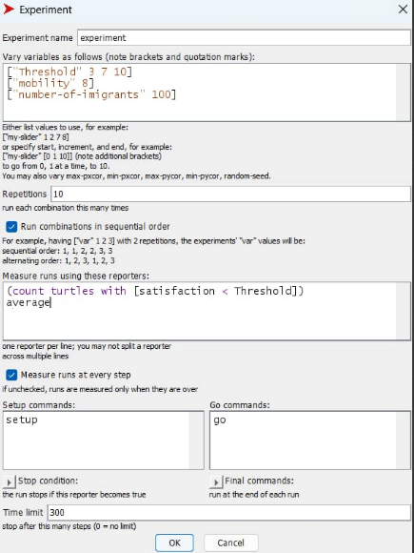
Explaining Outputs:
{
Behavior space varies the variable “Threshold” in 3 different time (3, 7, 10), holding the other variables constant at specific level. - To analyze these data, we took an average of the 10 repeated values at each threshold level and we configure the following table.
...
}

Slide 21
{
Immigrants Satisfaction Data
Threshold | 3 | 7 | 10
Average Satisfaction | 5.849585409 | 6.958120987 | 7.711999855
Average Number of dissatisfied Immigrants | 18 | 60 | 100
}

Slide 22
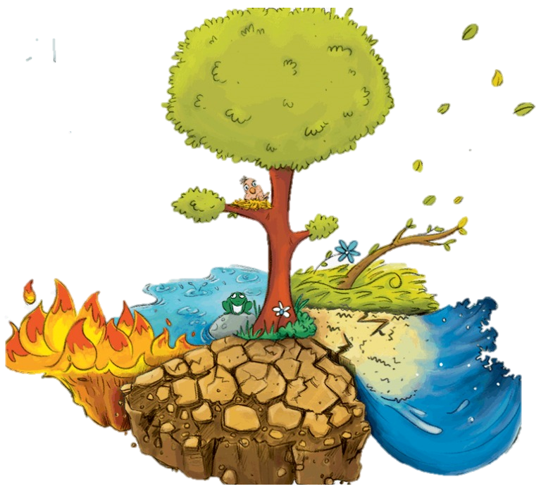

XII. Suggested Scenarios (Extensions):
Disasters Extension
Environmental Disasters
B) Economic disasters

Slide 23



XII. Suggested Scenarios (Extensions):
Controlled Migration Influx Extension:
Social Network Influence:

Slide 24
Conclusion

Slide 25
References
1. Güngör, Ö., Günneç, D., Salman, F. S., & Yücel, E. (2022). Prediction of Migration Paths
Using Agent-Based Simulation Modeling: The Case of Syria. Proceedings of the
International Conference on Industrial Engineering and Operations Management, Istanbul,
Turkey, March 7-10, 2022.
2. Deshmukh, V. (2018). Modeling Human Migration Dynamics in NetLogo. San Jose State
University, Master’s Projects 627.
3. Gilbert, N., & Troitzsch, K. G. (2005). Simulation for the Social Scientist. Open University
Press.
4. Rand, W. (2015). An Introduction to Agent-Based Modeling: Modeling Natural, Social,
and Engineered Complex Systems with NetLogo. MIT Press.

Slide 26
Thanks!

